Slide 1

M-Pesa: Simple Tech, Massive Impact
ow a Backend-First Solution Built Africa's Financial AP
Presented by [Karobia Backend-Focused Software Engineer]

Slide 2
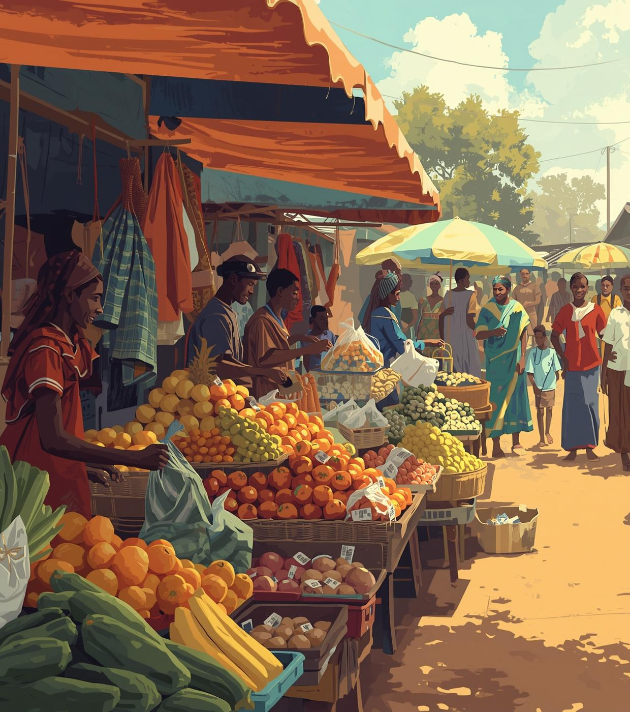
Financial Exclusion
The World Before M-Pesa
Banking was for the urban elite (less than 20% population).
Sending money required travel: costly, slow, and risky.
Cash economy limited savings, loans, and business growth.
Notes:
This wasn't just inconvenience; it was a structural barrier trapping millions outside the formal economy.

Slide 3
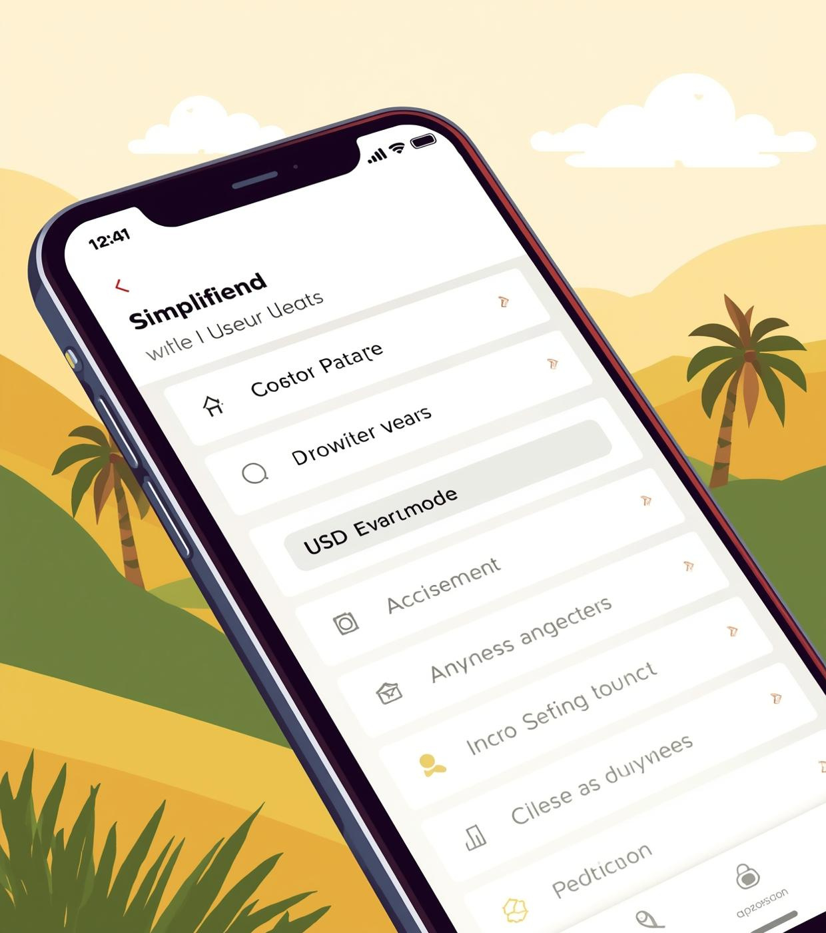
USSD & SMS Technology
Accessible financial services through simple, secure mobile technology for all Kenyans
• Works on any mobile phone, no internet needed
• Secure, simple, fast transactions for users
• Bridges the gap between people and financial services

Slide 4
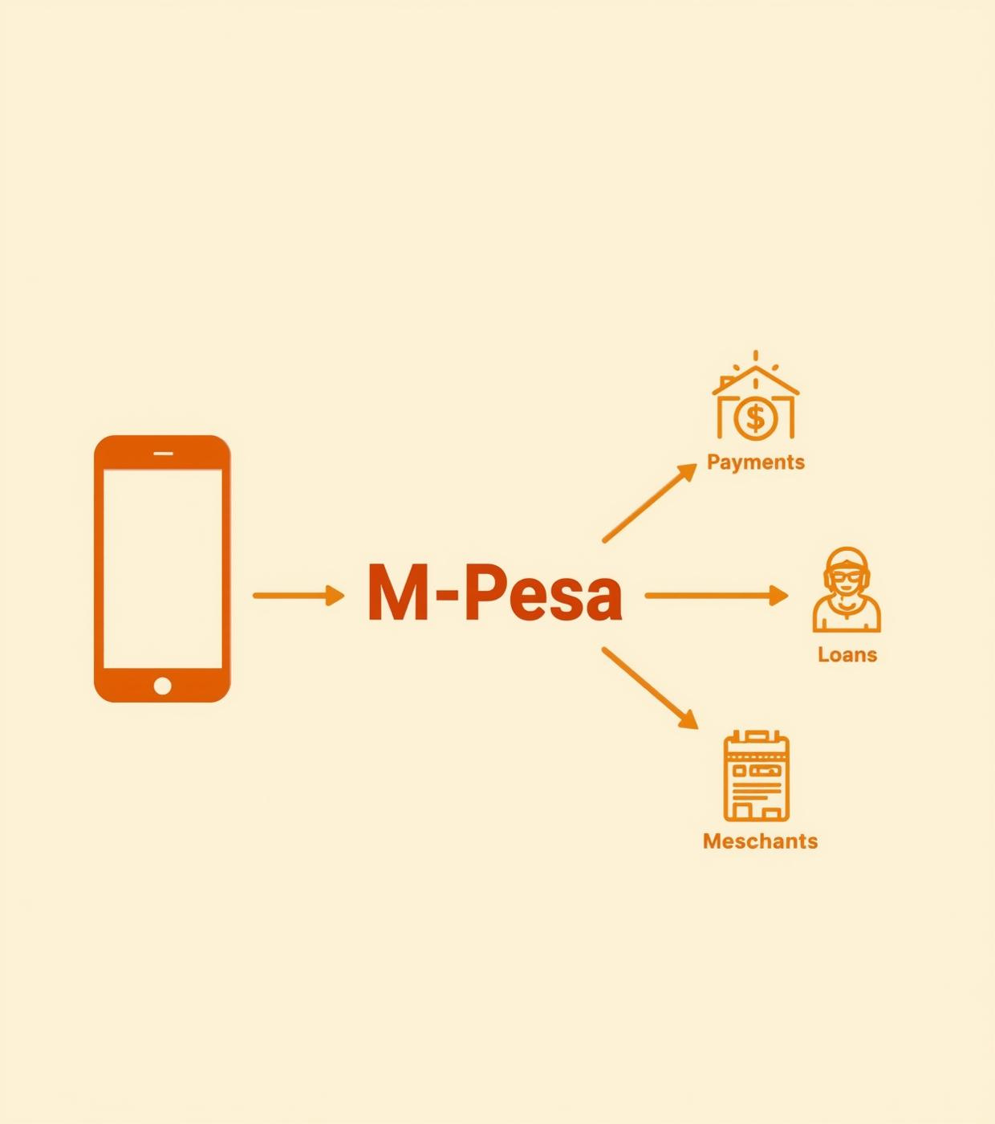
Simple, Powerful, Scalable
M-Pesa's architecture enables seamless integration without user complexity or confusion
• Just like an API: standardized inputs, reliable outputs
• Integrates multiple services effortlessly
• Users remain unaware of backend complexities

Slide 5
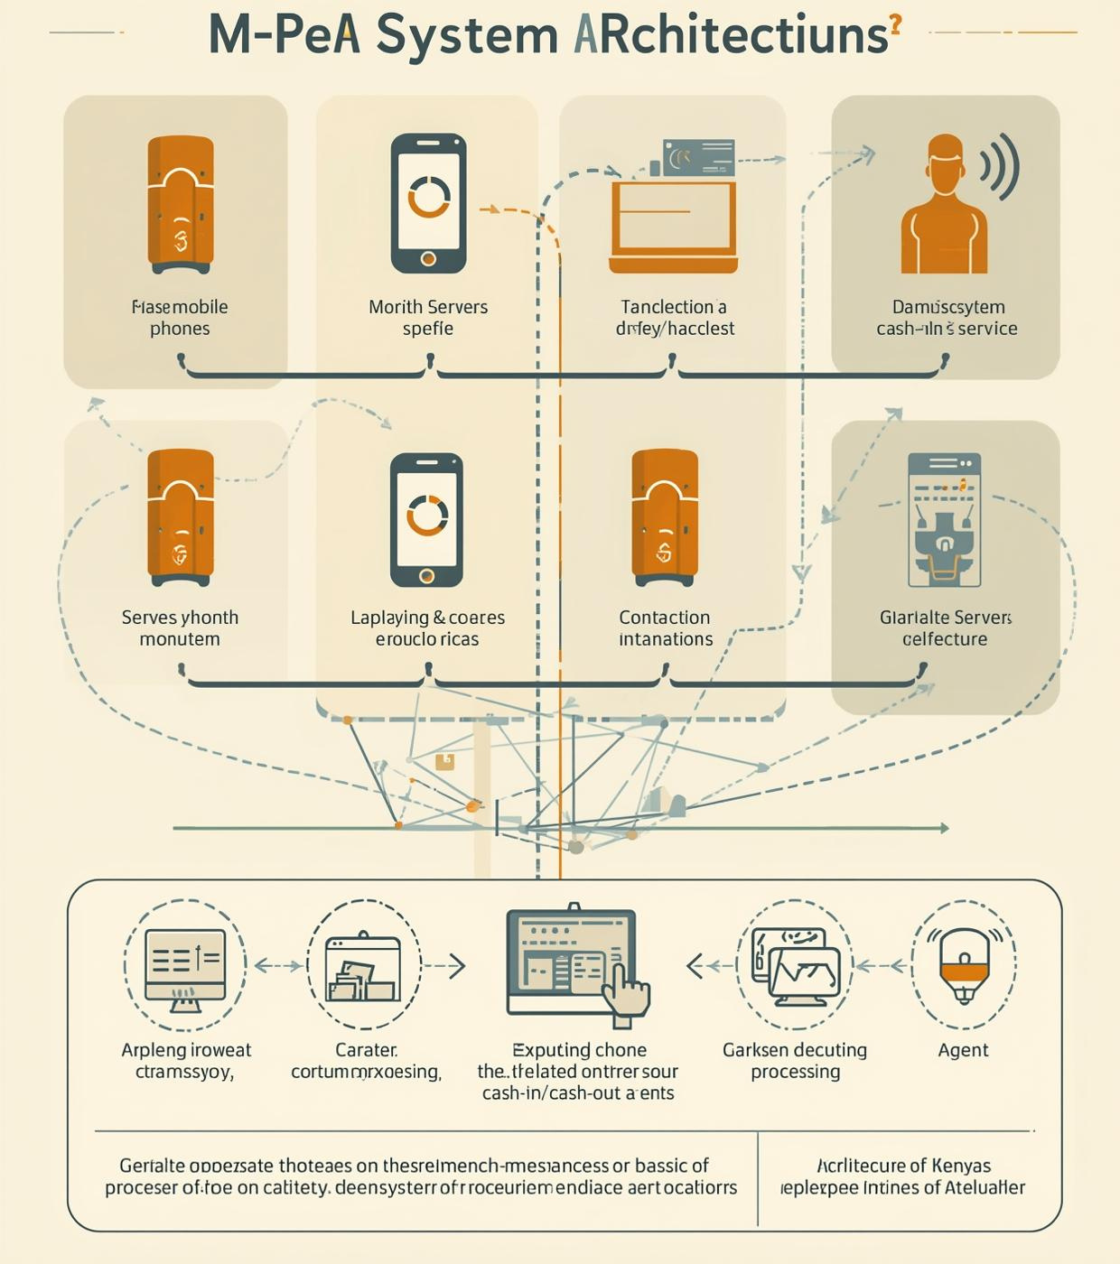
Backend & Agent Network
Transaction processing, physical agents, and a robust financial network in Kenya
• Backend: transaction processing, security, scalability
• Agents: physical presence for cash-in/cash-out
• Reliable network ensures system robustness

Slide 6
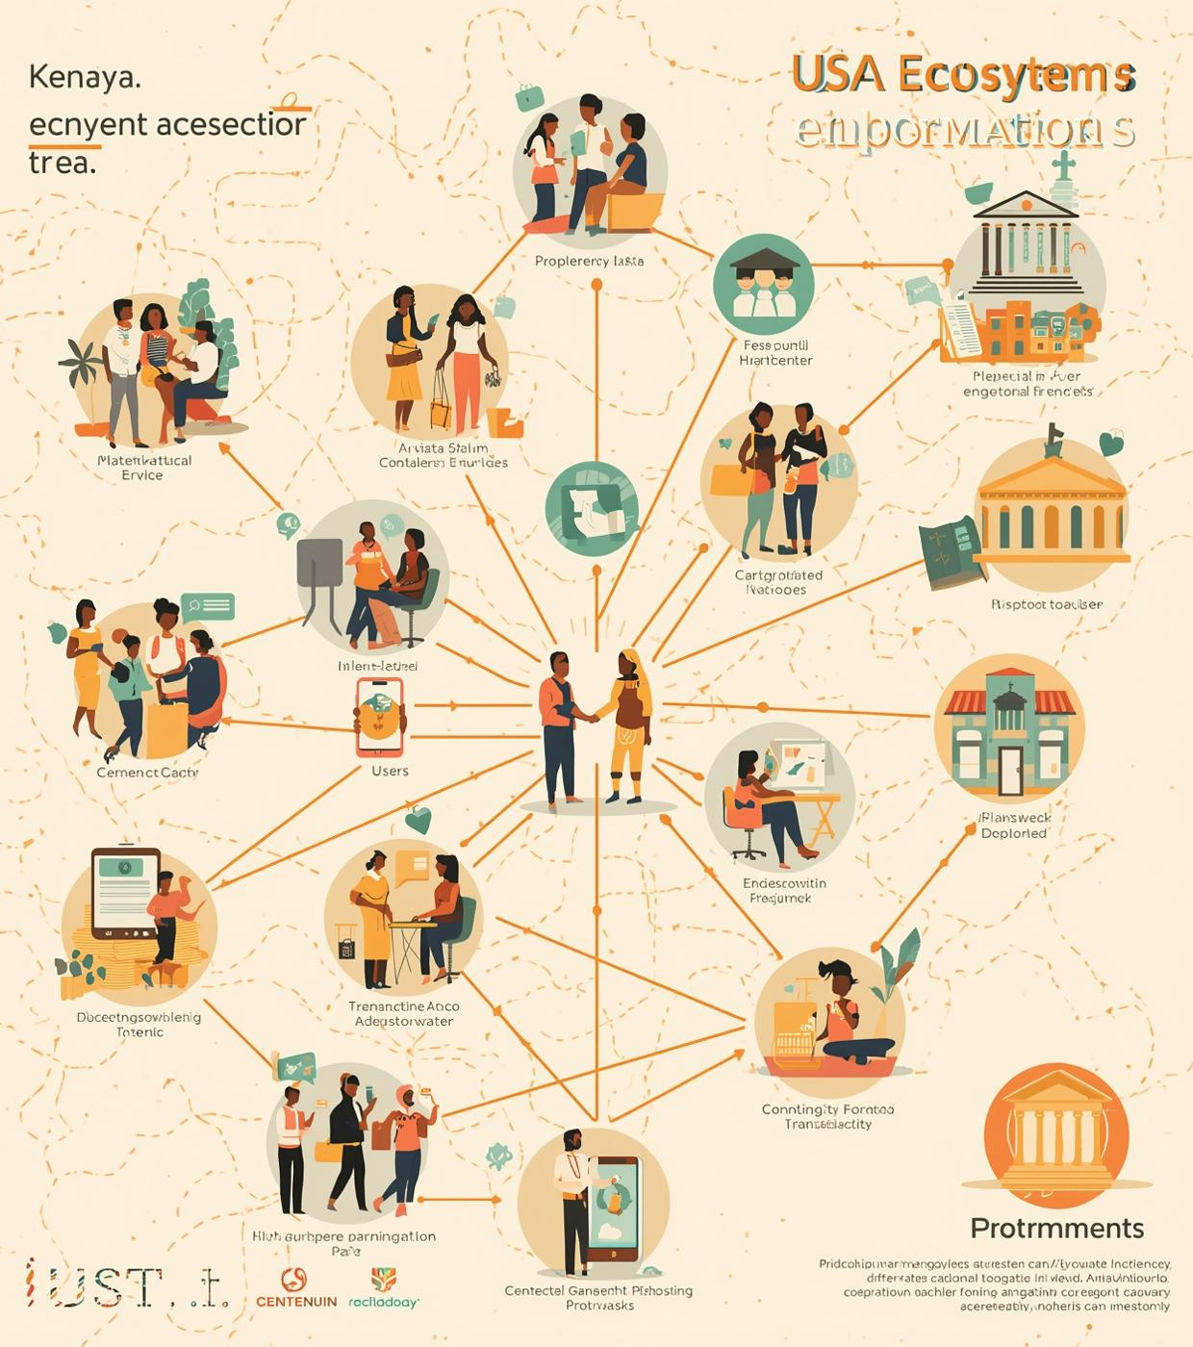
75%
Ecosystem Connectivity
75% of Kenyans now have access to financial services through M-Pesa, significantly bridging the gap between users, merchants, banks, and government services, enhancing economic participation.

Slide 7

Lessons from M-Pesa
Key engineering insights driving innovation and impact in financial technology solutions
• Robustness – transactions must never fail
• Context-awareness – adapt to mobile limitations & rural settings
• Platform-thinking – enable third-party services & innovation

Slide 8

Transforming Access
Simple technology can drive massive social change in communities
Email
hello@reallygreatsite.com
Phone Number
123-456-7890
Website
www.reallygreatsite.com

